Slide 1
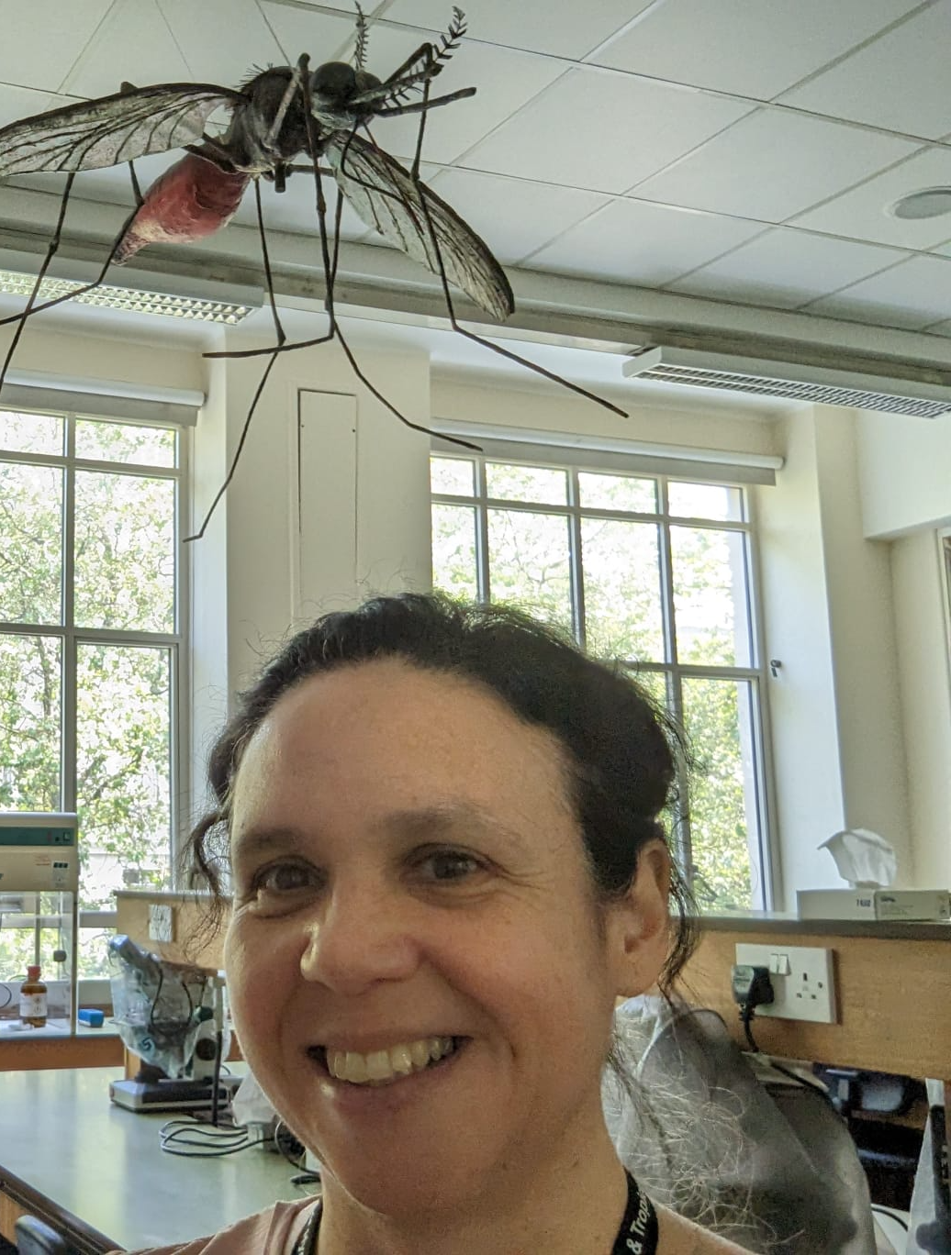
Using genomics and epigenomics to understand the evolution and molecular
mechanisms of antimalarial and insecticide resistance
Susana Campino
Prof. Genomics and Infections Diseases
Taane Clark
Prof of Genomics and Global Health
Susana.campino@lshtm.ac.uk
Taane.clark@lshtm.ac.uk
Notes:
This project aims to investigate the evolution of antimalarial drug resistance in malaria parasites and insecticide resistance in malaria vectors, providing critical insights into the mechanisms driving resistance and their implications for malaria control strategies.

Slide 2
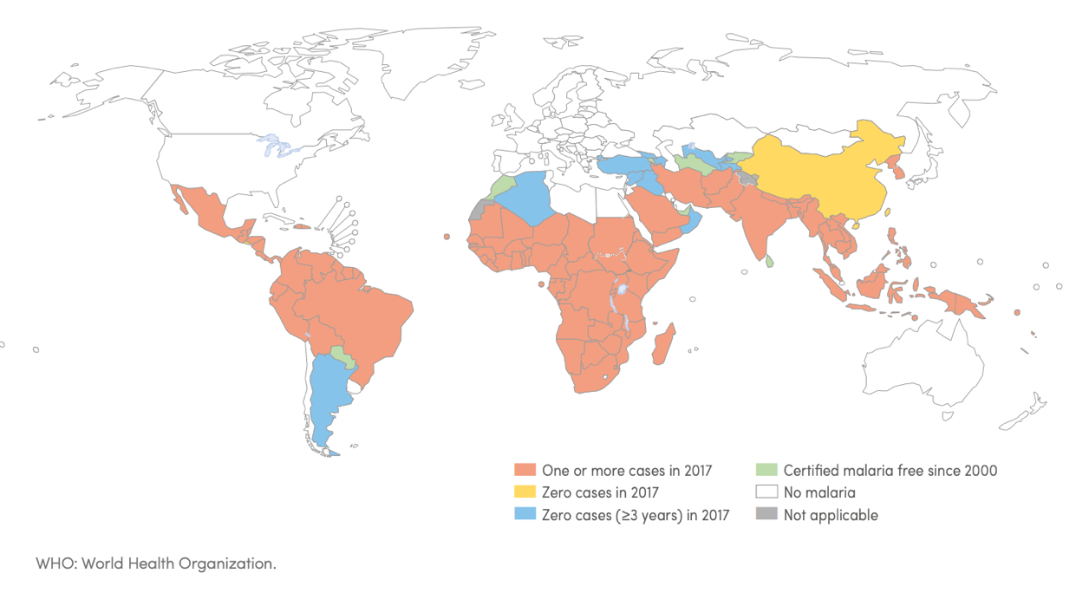
Malaria the problem
Caused by protozoan parasites of the Plasmodium genus
Transmitted by Anopheles female mosquitos
619 000 deaths / 247 million cases in 2022 (WHO)

Slide 3
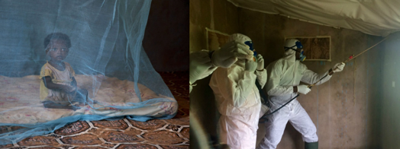
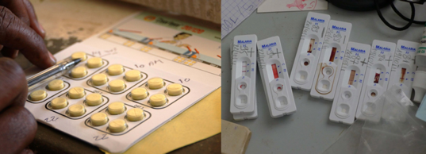
Malaria: control strategies
Anti-mosquito interventions
Insecticide-Treated Nets distribution
Insecticide Residual Spraying
destruction of larvae
Prompt diagnosis and drug treatment
Diagnosis (Microscopy, RDT, PCR)
Curative treatment
Chemoprevention
Prophylaxis
Seasonal Malaria Chemoprevention (SMC)
Mass Drug Administration
Vaccination

Slide 4
Malaria: control strategies ….. problems
Insecticide resistance within the vector
Vector and parasite genetic diversity is detrimental to control initiatives
Parasite drug resistance
Genetic diversity of field parasites

Slide 5
Some genes known, many unknow
Plasmodium falciparum genes involved in antimalarial resistance
For Plasmodium vivax no genes have been confirmed

Slide 6
The student will:
Use genomic data to characterize the genetic diversity and resistance profiles of Anopheles mosquitoes and Plasmodium parasites collected from South America, Asia, and Africa
Generate a comprehensive epigenetic map comparing Plasmodium strains that are resistant and susceptible to antimalarial drugs.
Identify epigenetic alterations that affect insecticide detoxification in vectors.
Develop new tools for rapid surveillance of resistance in field settings

Slide 7
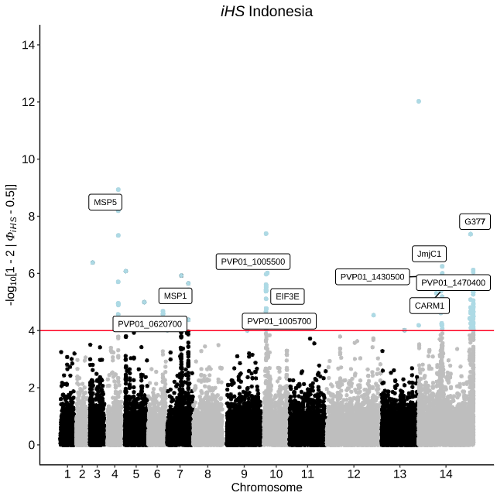
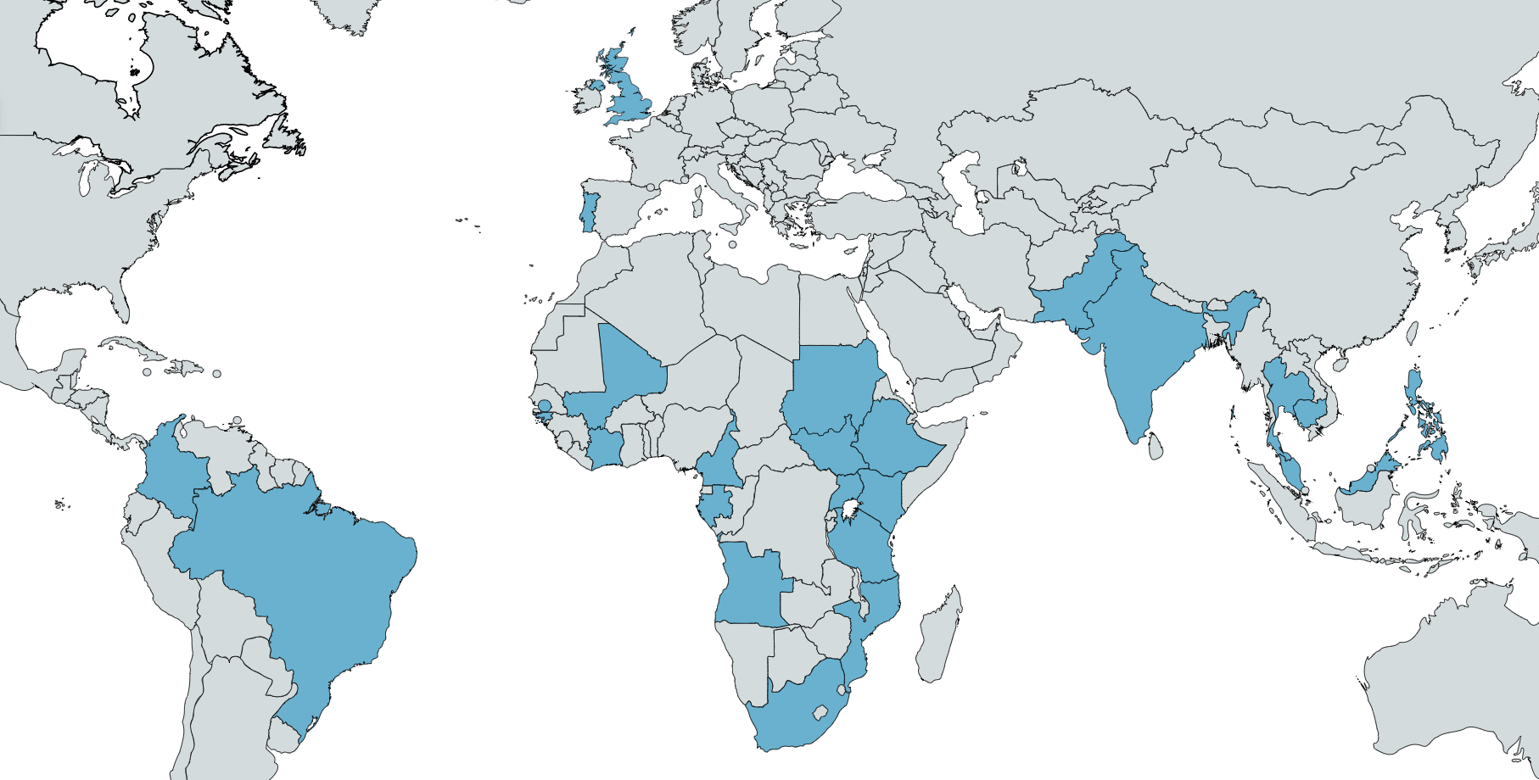
Identify new genes associated with resistance in parasites and vectors
AIM 1
Using >20 000 genomes
Applying population genetics and selection metrics
Oxford Nanopore (MinION)
Low/Medium throughput system
Many collaborators across malaria endemic areas
Use population genetics to identify candidate genes
Sequence parasite genomes

Slide 8
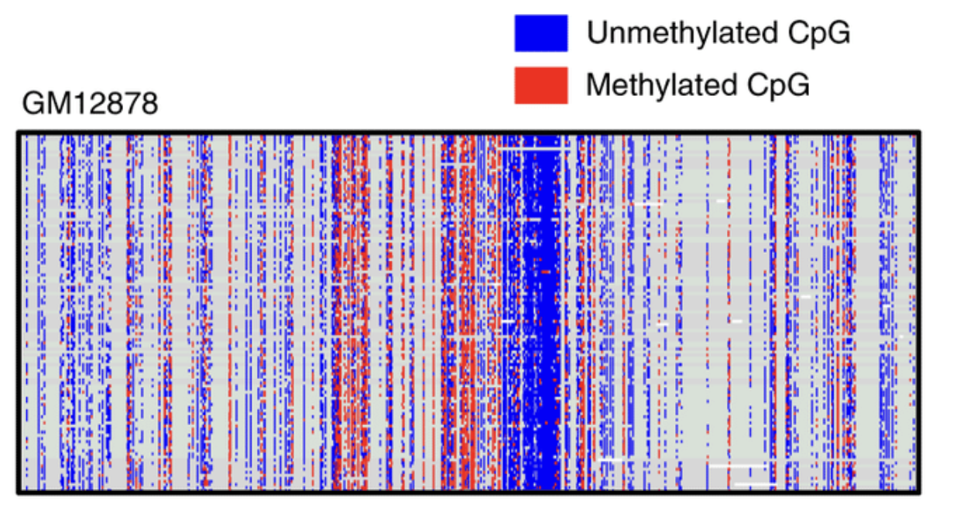
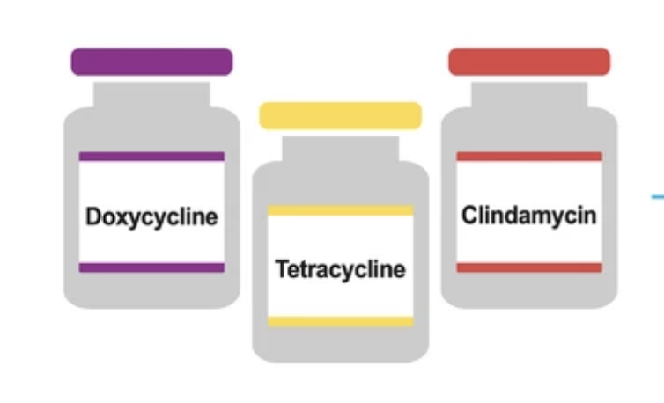
Identify new genes associated with resistance in parasites
AIM 2
Exploring for the first time the use of MinION to find epigenetics mechanism associated with parasite resistance
Look for changes in methylation patterns
Action of antimalarials
Parasites in culture
Oxford Nanopore (MinION)
Low/Medium throughput system

Slide 9
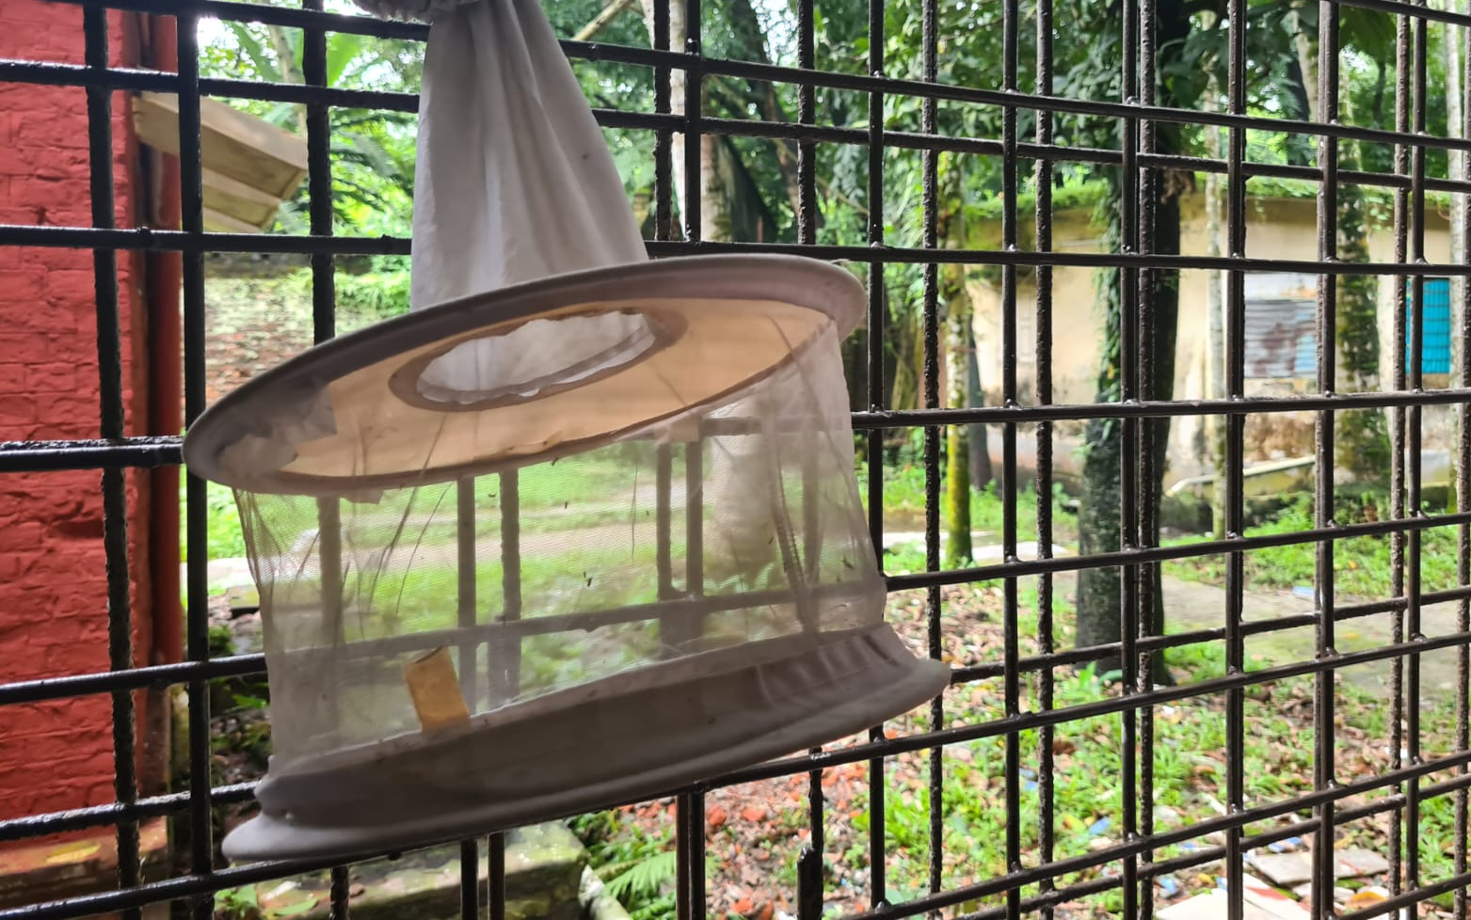
Apply same methods to explore insecticide resistance
Aim 3
Oxford Nanopore (MinION)
Low/Medium throughput system
Why are some mosquitos resistant to insecticides and other are susceptible?
What mutations confer resistance?

Slide 10
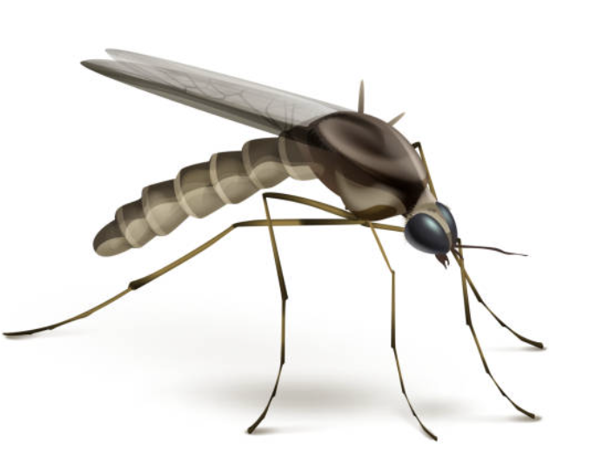
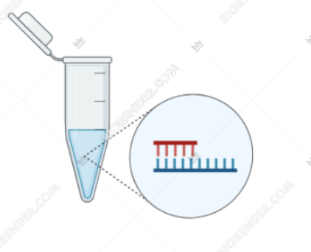
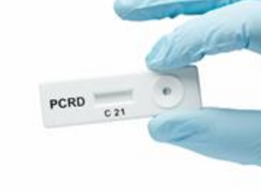
Working towards a DNA/ RNA-based rapid surveillance test
Aim 4
Lab dependent
Are these mosquitoes infected?
Are the parasites resistant to treatment?
Are the mosquitos resistant to insecticides?
Field deployable
A test that Includes several pathogens
Targeting antimalarial resistance mutations

Slide 11
Join a dynamic team of PhD students & postdoctoral researchers
specialized in genomics and global health
The insights gained from this project will help identify novel targets for future interventions to combat malaria drug and insecticide resistance.
To know more about the team visit:
The website: http://pathogenseq.lshtm.ac.uk/

